Slide 1
BRENTWOOD FIRE & RESCUE
Station 5 – 9551 Split Log Road

Slide 2
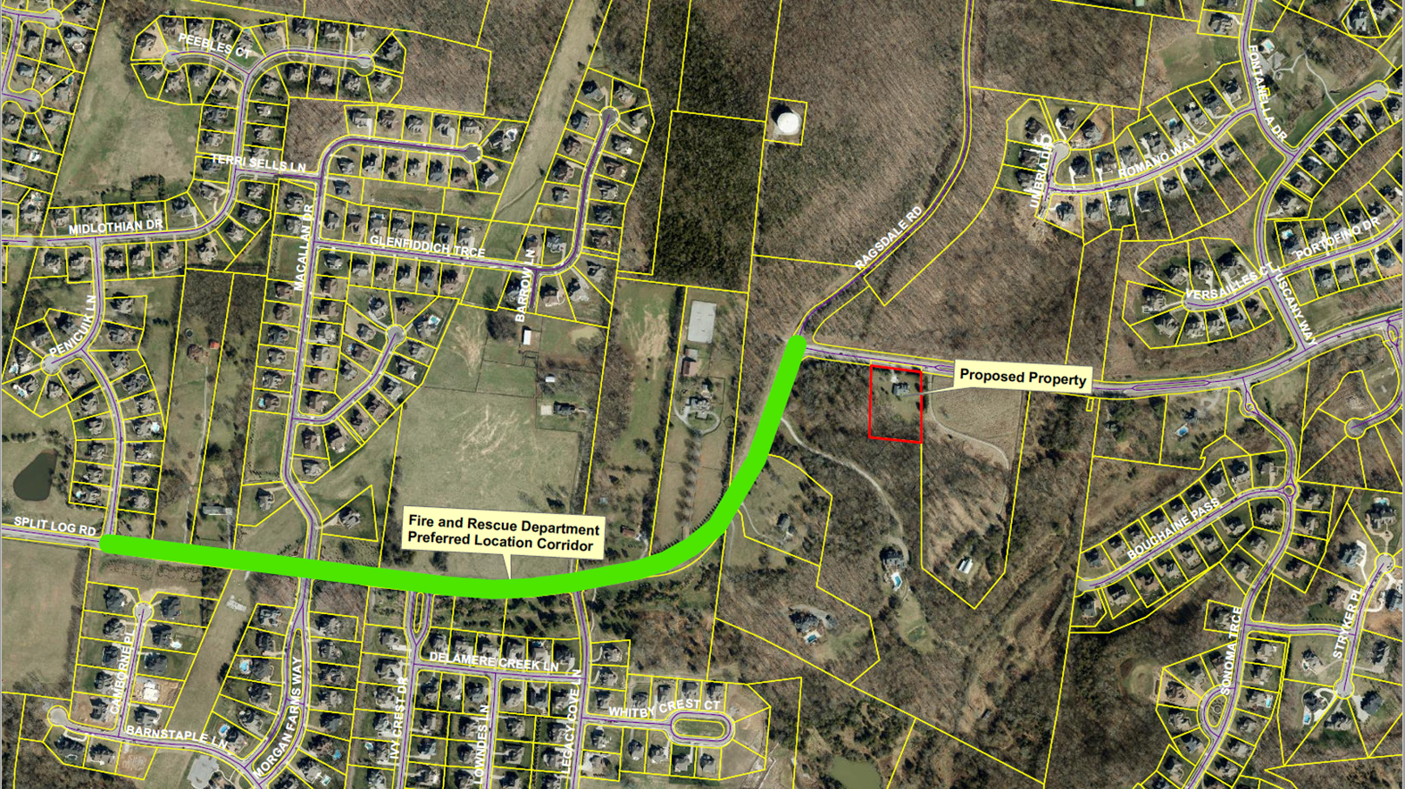
Proposed Fire Station 5 Location

Slide 3
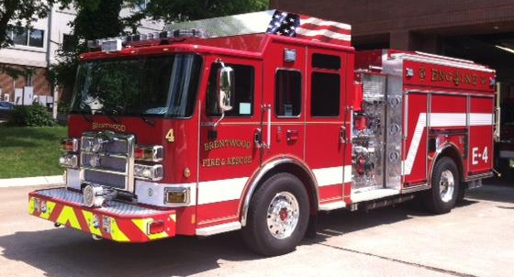
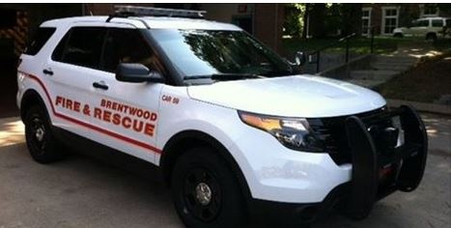
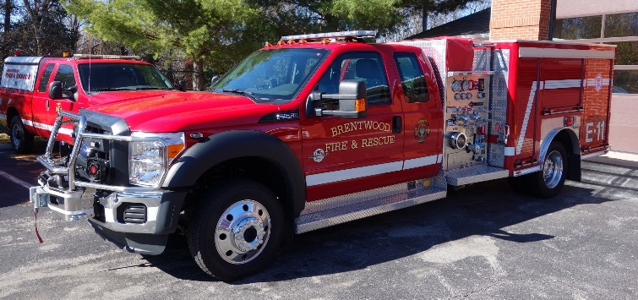
Our Challenge:
To Maintain and Improve Service Performance in Light of Increased Service Demands.

Slide 4
Indicators:
More Customers
43,889
2008 2018
24.50% increase in 10 years
15th largest city in Tennessee by population

Slide 5
Indicators:
More Responses
3,633
2,441
2008 2018 (proj.)
48.83% increase in 10 years
Expected to surpass 4,000 annual responses by 2020
Call volume increases are far outpacing population growth

Slide 6
Where we are today:
Unique demographics
Lower than average population density
90+% residential zoning
Brentwood maximizes the effectiveness of available resources
Must plan for continued growth and increased call volumes

Slide 7
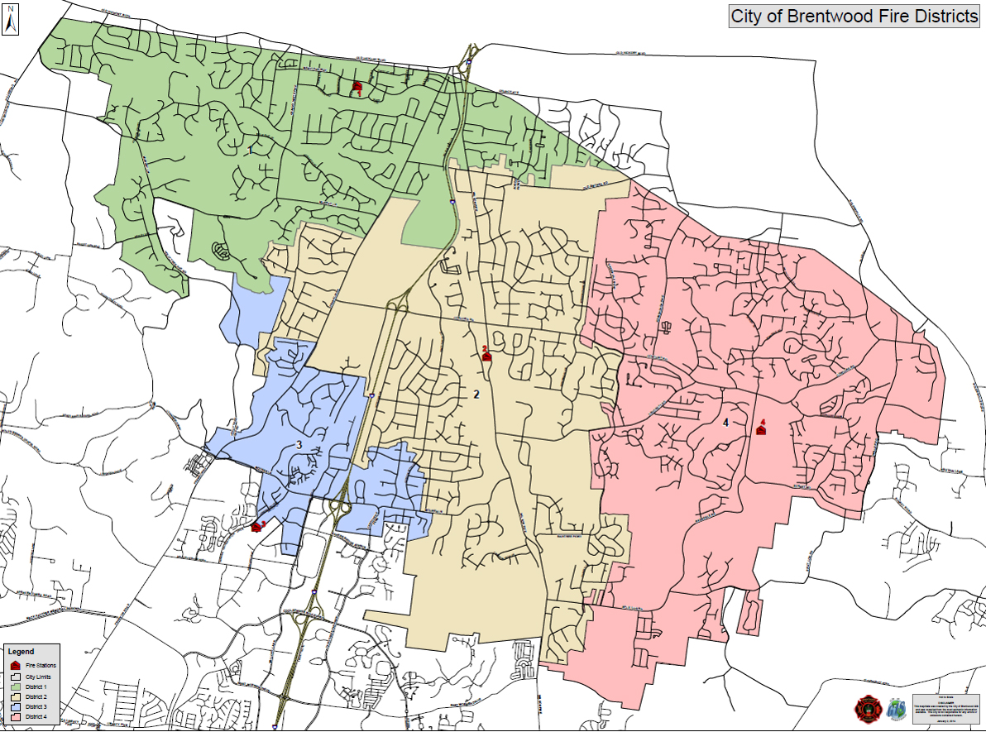
District 5:
Current City Limits
6.0 square miles
District 1
District 2
District 4
District 3
District 5

Slide 8
The Need for Station 5
Most significant growth and increased service demands
Southeast portion of Brentwood along Split Log/Wilson Pike
Call Volume:
Engine 4 (Sunset Road) - 51% increase between 2008 and 2018
Engine 2 (Wilson Pike) - 72% increase between 2008 and 2018
District 5 (Split Log/Wilson Pike) - 72.5% increase in call volume in last two years
(2016- 2018)

Slide 9
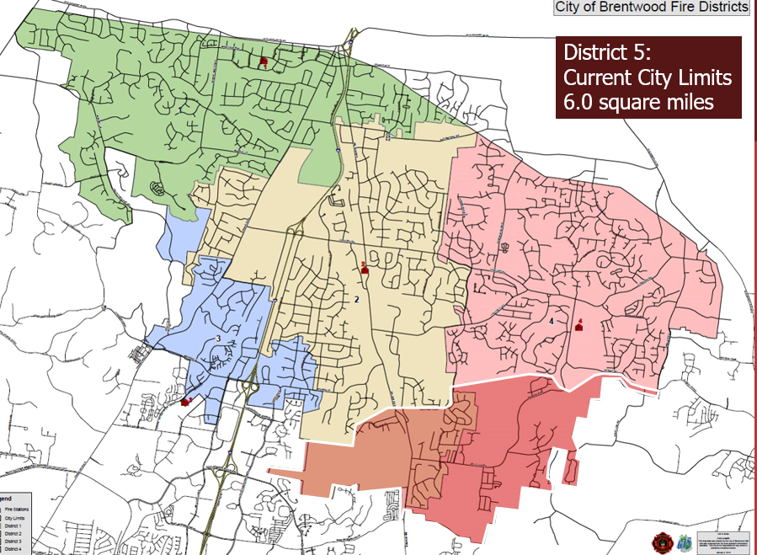
Proposed District 5: Split Log and Wilson Pike Area
Call Response Times:
Target response time -- 6 minutes 50 seconds
90% of all city calls achieve this
Current District 5 response time -- 12 minutes 9 seconds
Proposed District 5

Slide 10
Station 5 Timeline
Fall 2018: Purchase Land at 9551 Split Log Road
2018-2020: Lease agreement with current property owner to live on property for monthly rental fee
2020-2021: Tentatively set to begin design and/or construction

